Slide 1
Vector Autoregression (VAR) Models
Quick review
Ugo Panizza

Slide 2
The origins of VAR
The VAR methodology was originally developed by Sims in a 1980 Econometrica paper titled “Macroeconomics and Reality”
In that paper Sims said that standard multi-equation macroeconomic models are full of “incredible” restrictions
His approach is the opposite of the Box and Jenkins.
  Rather than being parsimonious, let’s be profligate and insert more variables

Slide 3
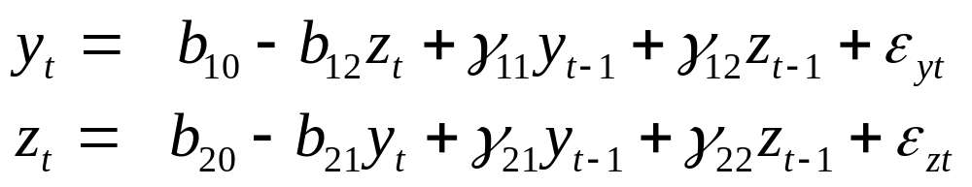



Structural VAR
Can we estimate this?
Consider a bivariate, first-order VAR
  y and z are stationary and the ε are uncorrelated white noise disturbances:
In this system y and z affect each other; -b₁₂ is the contemporaneous effect of z on y, and -b₂₁ is the contemporaneous effect of y on z
  Note that ε_{y} (ε_{z}) is an innovation to y (z), but if b₂₁ (b₁₂ ) is different from zero ε_{y} (ε_{z}) has an indirect contemporaneous effect on z (y).

Slide 4
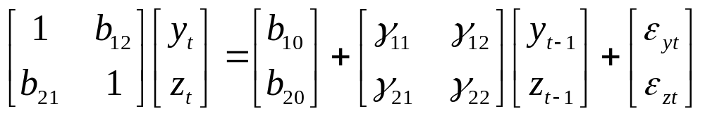

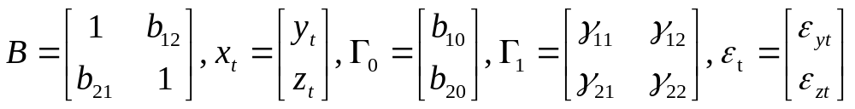
Can we estimate this?
NO!
  Why? Because it’s not a reduced form equation (in fact, it’s called “structural” VAR). Let’s rewrite it as:
  or
or primitive form

Slide 5
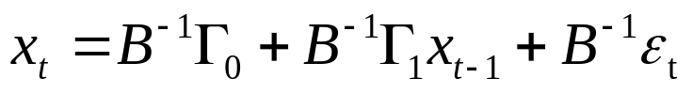
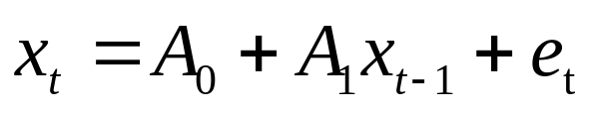
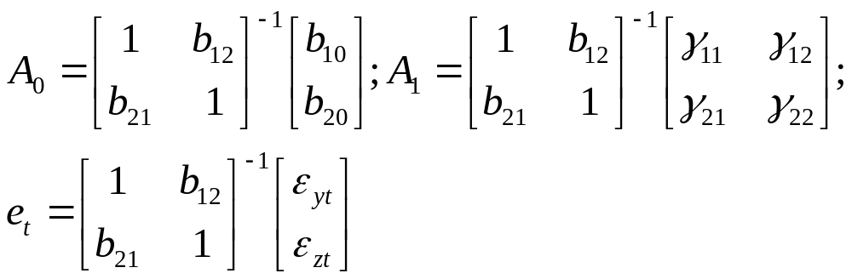
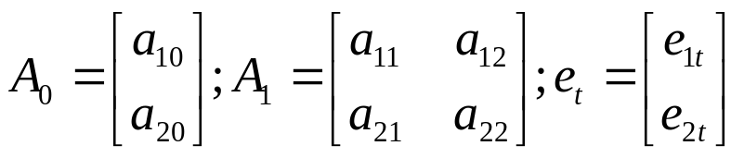
VAR in standard form
Premultiply by B⁻¹ and get the VAR in standard (or reduced) form

Slide 6
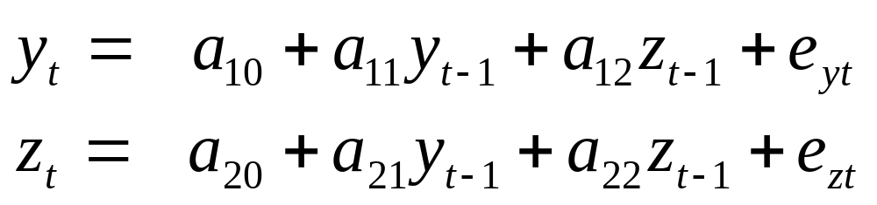
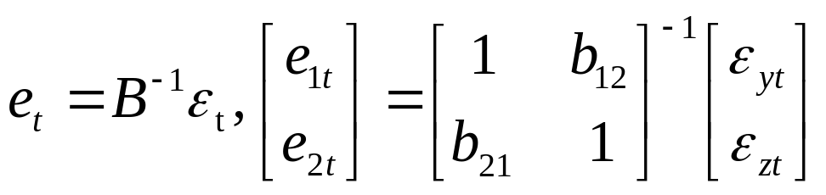
VAR in standard form
Premultiply by B⁻¹ and get the VAR in standard (or reduced) form
We can estimate this with OLS equation by equation
(but with SUR could be more efficient)
The error term is composed of two shocks

Slide 7
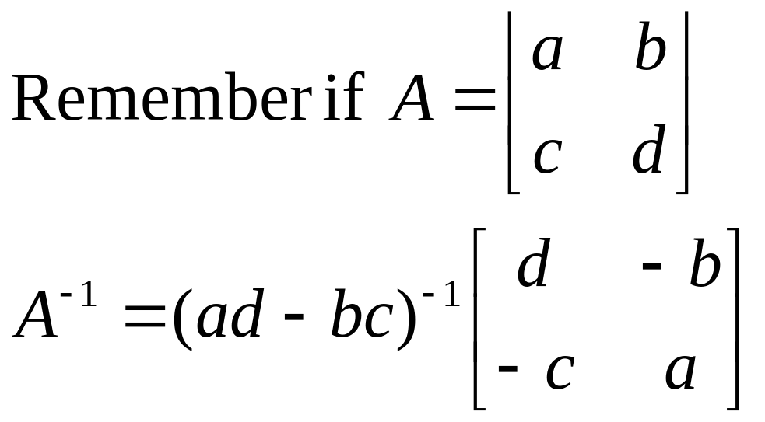
VAR in standard form
  The error term is composed of two shocks

Slide 8
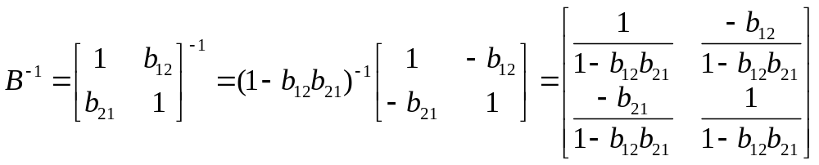
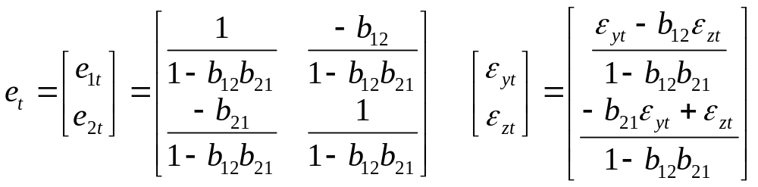
VAR in standard form
  The error term is composed of two shocks

Slide 9

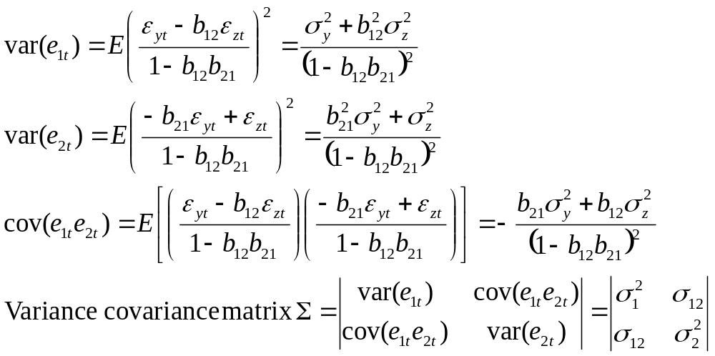
Variances

Slide 10
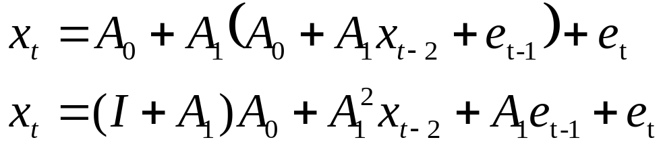
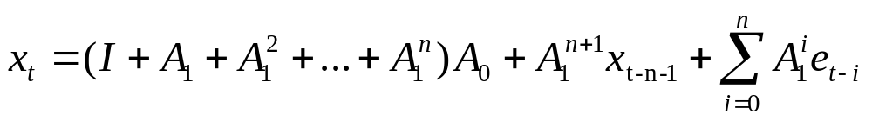
Stationarity
An AR(1) process is stationary if φ<1
  Here, we have a similar concept
Start with
and iterate backward
…after n iterations:
This will converge if A₁^{n} goes to zero when n goes to infinity.
In a VAR with two variables it can be shown that this requires that the roots of (1-a₁₁L)(1-a₂₂L)-(a₁₂a₂₁L²) lie outside the unit circle

Slide 11
Counting parameters
Let’s step back
What we care about is the structural VAR, but we can only estimate the reduced form VAR
But here we have a problem
In the structural VAR we have 10 parameters (4 bs, 4 γs and the variances of the error terms)

Slide 12
Counting parameters
Let’s step back
What we care about is the structural VAR, but we can only estimate the reduced form VAR
But here we have a problem
In the reduced form VAR we can estimate 9 parameters (6 a parameters, and the variances and covariance of the error terms)

Slide 13
Counting parameters
Let’s step back
What we care about is the structural VAR, but we can only estimate the reduced form VAR
But here we have a problem
  In the structural VAR we have 10 parameters
  In the reduced form VAR we can estimate 9 parameters
  There is no way we can recover the 10 parameters of the structural form with the 9 parameters of the reduced form
BIG PROBLEM!!!!

Slide 14
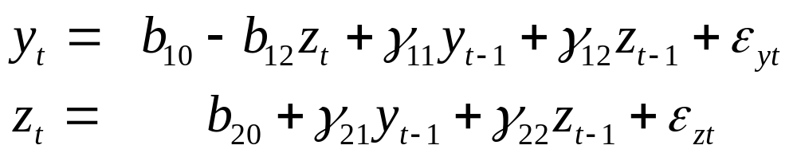
Counting parameters
How do we deal with this issue?
We impose a restriction
The usual (but probably wrong) way to do this is to impose an ordering
    This is a bit funny, is this restriction “credible”?
  Assume that you are ready to claim that y has no direct impact on z (or b₂₁=0).
The VAR becomes recursive

Slide 15
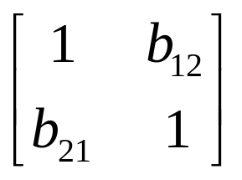
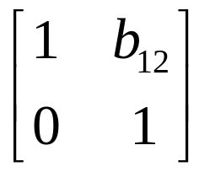
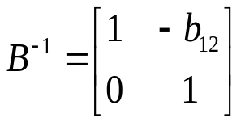
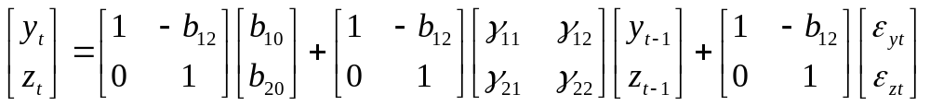
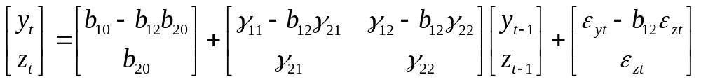
Counting parameters
B is no longer
and
but it becomes
We made up a parameter!
Thus:
The z shock has a contemporaneous effect on y, but the y shock has no contemporaneous effect on z

Slide 16
Counting parameters
We estimate

Slide 17
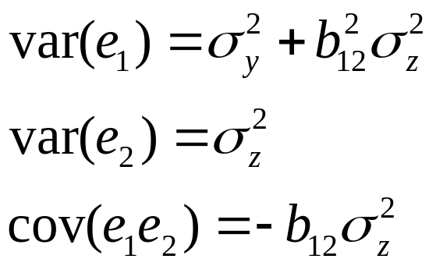
Counting parameters
We estimate
Now we are fine, because we have 9 unknown and we are estimating 9 things

Slide 18
Identifying a VAR
Note that we always have this problem.
If we have a VAR with N variables, B is always an NxN matrix
  Since the elements of the diagonal are always ones, B has NxN-N unknowns
  We also have N unknown variances of ε
So we have NxN-N+N unknowns ie N² unknowns

Slide 19
There are known knowns. These are things we know that we know. There are known unknowns. That is to say, there are things that we know we don't know. But there are also unknown unknowns. There are things we don't know we don't know.
  Donald Rumsfeld
It ain't what you don't know that gets you into trouble. It's what you know for sure that just ain't so.
  Mark Twain

Slide 20
Identifying a VAR
We have to recover these unknowns with the estimates of the variance-covariance matrix (the other estimates are already used to recover the gammas and the constant)
  Since the variance-covariance is symmetric it only has (N²+N)/2 distinct elements
  N elements along the principal diagonal, N-1 elements along the first off diagonal, N-2 elements in the next diagonal, … one element in the corner. The total is (N²+N)/2
So we need N² and we only have (N²+N)/2.
  The difference is N² - (N²+N)/2= (N²⁻N)/2
We need to impose (N²⁻N)/2 restrictions in the system
  If we have two variables 1 restriction, if we have 3 variables we need 3 restrictions, if we have 4 variables we need 6 restrictions, if we have 10 variables we need 45 restrictions!

Slide 21
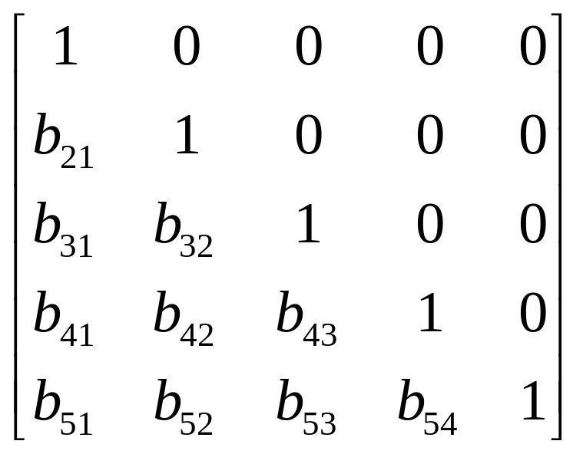
Identifying a VAR
5 variables
(25-5)/2=10 restrictions
Count the zeros:
b₁₂=b₁₃=b₁₄=b₁₅=b₂₃=b₂₄=b₂₅=b₃₄=
=b₃₅=b₄₅=0

Slide 22
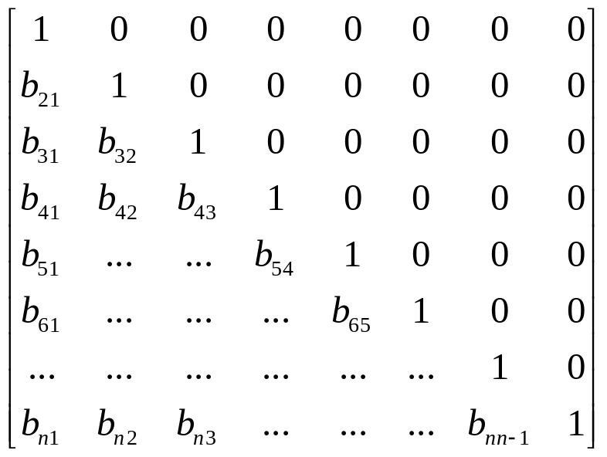
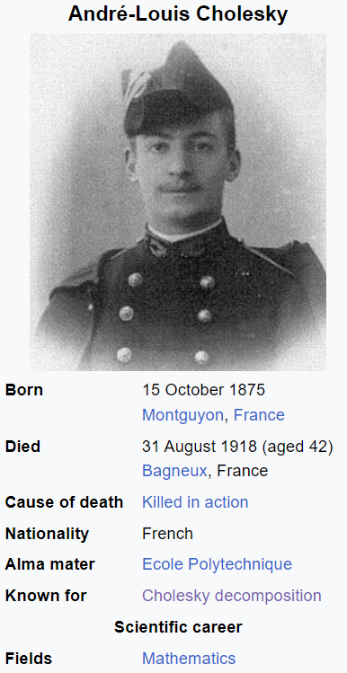
Identifying a VAR
If we use the recursive system adopted before and have N variables, we need to write the B matrix as
This is called a Choleski decomposition

Slide 23
Estimation
We can estimate the system one equation at a time with OLS
  SUR does not make the estimation more efficient because we have the same variables in the RHS
    However, if some variables (or lags) are not included in all equations (i.e., you have a Near VAR) SUR yields more efficient estimates
Key issues
What variables should you include?
  Economic theory should guide you
How do you decide lag length?
  If p is too small, the model is misspecified
  If p is too big you lose dof
    Note that if you have N variables and p lags, you need to estimate n*p+1 parameters for each equation (in total we estimate p*n²+n parameters) and you may soon run out of degrees of freedom
Ordering
  This is irrelevant for estimation purposes
    (IRRELEVANT FOR ESTIMATIONS PURPOSES, BUT KEY FOR INTERPRETATION)

Slide 24
How do you decide lag length?
The lagged variables are highly collinear so test on individual lags do not make much sense
You may be tempted to use an F test equation by equation,
But this is not appropriate because the lag length affects all the equations simultaneously
So you want a joint test for all equations

Slide 25


How do you decide lag length?
A proper test for cross-equation restrictions is a likelihood ratio test. Do as follows:
  Start with the longest plausible lag length
    Quarterly data, multiples of 4, monthly data, multiples of 12
  Estimate the VAR and compute the VAR-COV matrix Σ_{u} (u for unrestricted). Compute the determinant of Σ_{u}
  Estimate the VAR with a shorter lag length (OVER THE SAME SAMPLE PERIOD) and compute the VAR-COV matrix. Call it Σ_{r} (r for restricted), Compute the determinant of Σ_{r}
  The likelihood ratio test is
  However Sims (1980) suggests to use
    T is the number of usable observations, c is the number of parameters to be estimated in the unrestricted system and |Σ| is the determinant of Σ.
    LR has a chi squared distribution with DOF equal to the number of restrictions in the system (u-r)n^2.

Slide 26
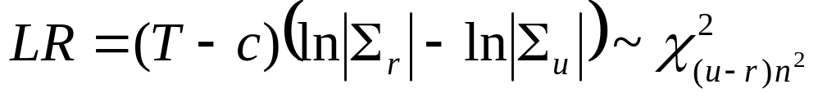
How do you decide lag length?
Example assume you have 20 years of quarterly data, a system with 3 variables (n=3)
You start with p=12. You compute |Σ_{u}|=15
Then, you estimate the model with p=8 and find that |Σ_{r}|=20
  T = 20*4-12 =68; c = 1+12n=1+12*3=37;
  LR = (68-37)(ln(20)-ln(15))=8.92
  DOF:
    (12-8) restrictions in each variable, so 4*n^2 =36 restrictions
  The 5% critical value (under the null that the right model is the restricted model) for a chi squared with 36 degrees of freedom is approximately 50
  So, we do not reject the null that the appropriate lag length is 8, so I can try with 4 lags

Slide 27
How do you decide lag length?
There are some problems with the LR test
  You can only make pairwise comparisons
  It requires normally distributed errors in each equation
  It may say that you are OK when you compare 12 with 8 lags and when you compare 8 with 4 but that you are not OK when you compare 12 with 4
    More in general, in econometric the fact that x is SS and y is not SS does not mean that x-y is SS

Slide 28
How do you decide lag length?
An alternative is to use one of the following information criteria
  MAIC=ln|Σ|+2k/T
  MSBIC= ln|Σ|+(k/T)ln(T)
  MHQIC=ln|Σ|+(2k/T)ln(ln(T))
    k total number of regressors in the system: k=n*p+n
  Note that these are not tests, they just give you a ranking

Slide 29
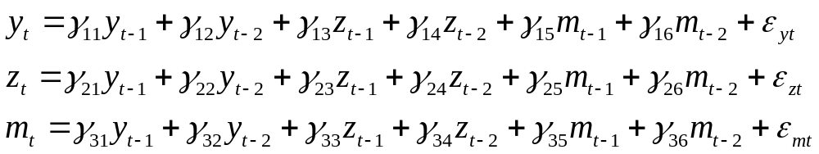

Once we estimate the model what do we do with it?
Maybe you have a system with three variables and 2 lags
We can stare really hard at the parameters
Keep staring!
You will find that parameter at some lags are positive at other lags negative, you have no clue about the total effect
What you want to know is how a shock to one variable affects the other variables in the system

Slide 30
Once we estimate the model what do we do with it?
Maybe you have a system with three variables and 2 lags
We can stare really hard at the parameters
Keep staring!
  You will find that parameters at some lags are positive, at other lags they are negative. You will have no clue about the total effect
  Some of them are SS other are not, but huge amount of multicollinerity
What you want to know is how a shock to one variable affects the other variables in the system

Slide 31
EXAMPLE
We use a dataset that contains quarterly data on national income, private consumption, and nonresidential investment for the United States from 1947 through the first quarter of 2006.
The variables pincome, pinvestment, and pconsumption contain percent changes at an annualized rate.
The three series are correlated for several reasons. For example, if residents' incomes increase, then they will likely go out and purchase more goods. Increased investment today may lead to higher productivity and income later and hence higher future consumption.

Slide 32
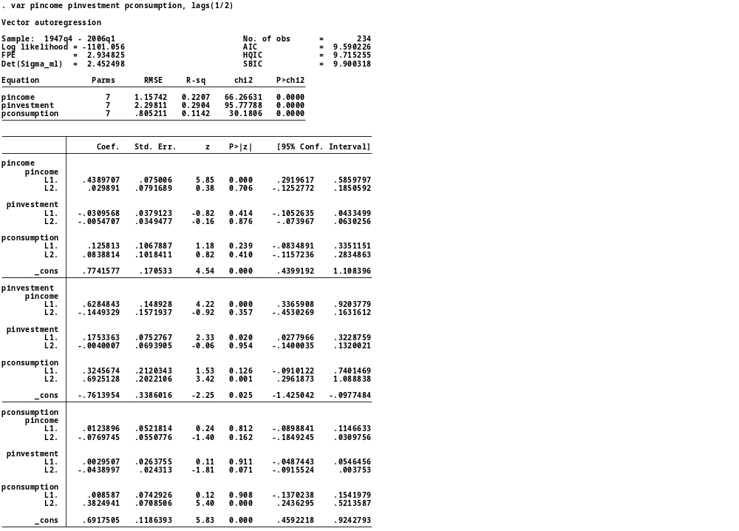
We use two lags
Can you interpret the regression coefficients? (assuming that you can see them)

Slide 33
Impulse response function
We want to express the variables in the system as a function of the shocks
This can be done because, like an AR has an MA representation, a VAR has a VMA representation
The VMA is an essential feature of Sims’s methodology because it allows to trace the effect of the shocks on the variable contained in the VAR system

Slide 34
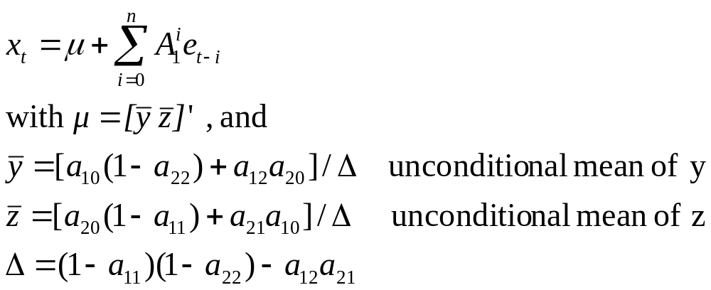
Impulse response function
We start with
We rewrite it as:
If the stability conditions are met, we can rewrite it as

Slide 35
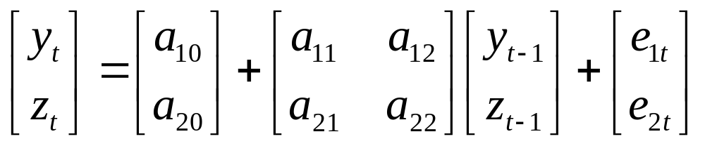
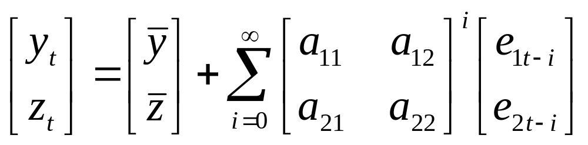
Impulse response function
In other words, we go from
to

Slide 36
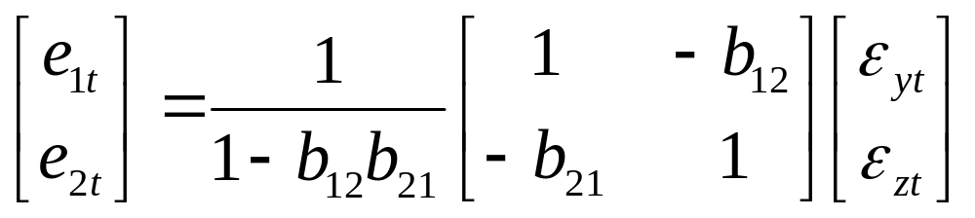
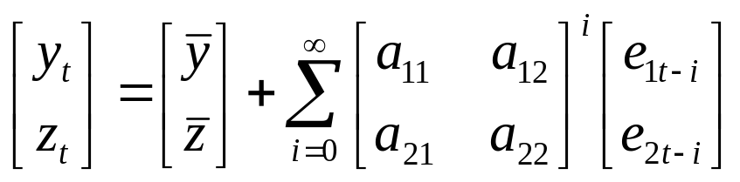
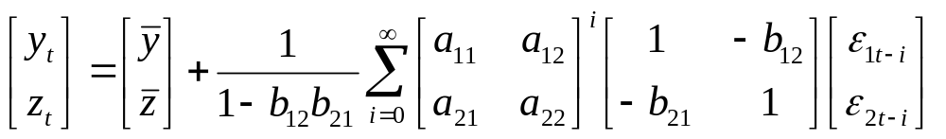
Impulse response function
Rewrite the errors as
And plug it into
We get

Slide 37
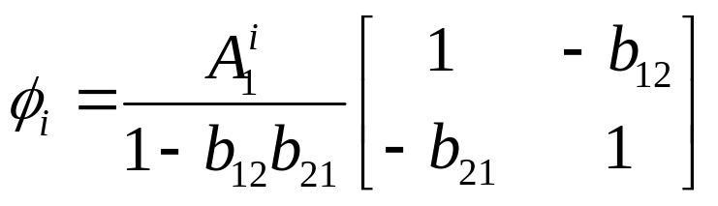
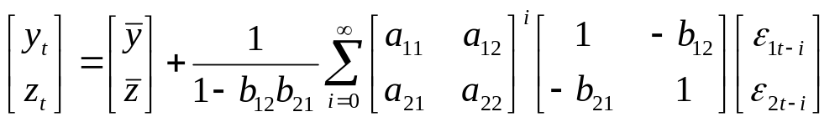
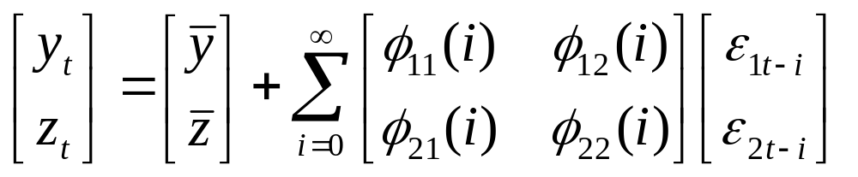
Impulse response function
Now, this is becoming messy. Write
And plug it into
We get

Slide 38
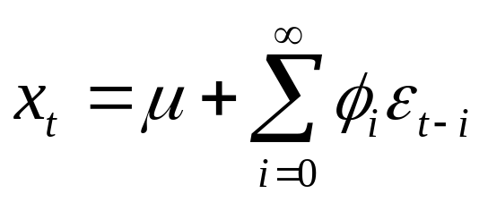
Impulse response function
Now, this is becoming messy. Write
And plug it into
We get
More compact notation

Slide 39
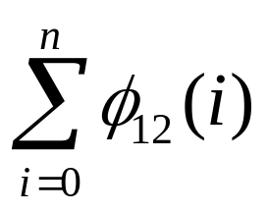
Impulse response function
This is cool because you can use the φ to look at the effect of ε on the entire time paths of y and z
φ_{jk}(0) are the impact multipliers.
  For instance, φ₁₂(0) is the impact of a change in ε_{zt} on y_{t}.
  Similarly, φ₁₂(1) is the impact of a change in ε_{zt} on y_{t+1}, and φ₁₂(2) is the impact of a change in ε_{zt} on y_{t+2}
  You can find the cumulative impact by summing the various φ. After n periods, the cumulate effect of ε_{zt} on the {y_{t}} sequence is
When n goes to infinite, we have the long-run multiplier

Slide 40
Impulse response function
Again:
The φ_{jk}(0) are the impact multipliers
The are the cumulative multipliers
The for n➔oo are the long-run multipliers

Slide 41
Impulse response function
The four sets of coefficients φ₁₁(i); φ₂₂(i); φ₂₁(i); φ₁₂(i) are called impulse response functions (IRF)
Plotting the impulse response function is a practical way to look at the impact of ε on y and z.
Note that in order to build the IRF and trace out the effect of the pure shocks we need to know all the parameters of the primitive system
But we don’t know them!
  The estimated VAR is underidentified
    We are missing (N²⁻N)/2 parameters

Slide 42
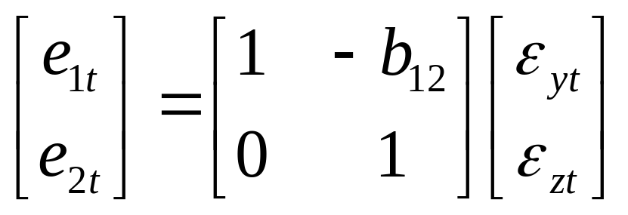
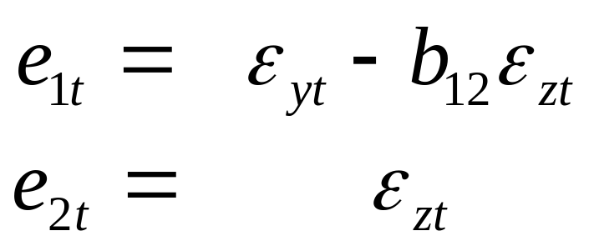
Identifying IRF
One possibility is to use the same Cholesky decomposition discussed before
Remember that with our n=2 VAR the errors were
If we set b₂₁=0

Slide 43
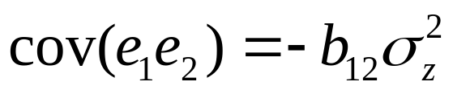
Identifying IRF
By doing this we equate e_{2t} (which we can estimate) to ε_{zt}.
Then, we can recover b₁₂ by computing the variance of e₂ and the covariance of e₁e₂ and recalling that
Notice that the Cholesky decomposition does not allow for any direct effect of ε_{y} on z. But, we still have an indirect lagged effect because y_{t-1} has an effect on z_{t}.

Slide 44
Identifying IRF
So, the decomposition generates an asymmetry in the system.
  One shock has a contemporaneous effect on all variables but the other shock has only a lagged effect on one of the two variables
This is why this is called an ordering
In our case, z is said to be causally prior to y
A unit shock to z causes z to jump by one unit
and y to jump by –b₁₂
A unit shock to y causes y to jump by
one unit but has no contemporaneous effect on z

Slide 45
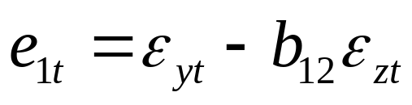
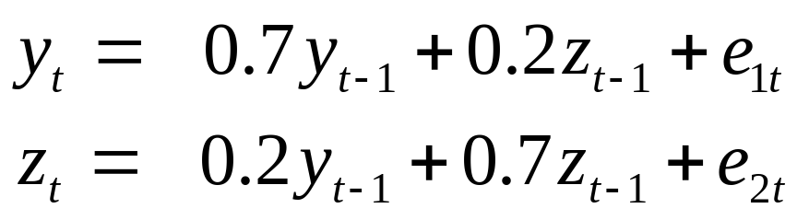
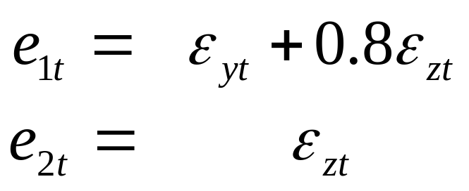
Example
Assume we estimate a VAR and we find a₁₀=a₂₀=0; a₁₁=a₂₂=0.7, and a₁₂= a₂₁=0.2. var(e₁)=var(e₂)=1, cov(e₁,e₂)=0.8
  We have a unit shock to ε_{zt}.
    In period 0 z goes up by one and y goes up by 0.8. In period 1 z goes up by 0.7+0.2*0.8=0.86 and y goes up by 0.7*0.8+0.2*1=0.76. In period 2 z goes up by 0.2*0.76+0.7*0.86=0.754 and y goes up by 0.7*0.76+0.2*0.86=0.704. They converge
  We have a unit shock to ε_{yt}.
    In period 0 y goes up by one and z doesn’t change. In period 1 z goes up by 0.2 and y goes up by 0.7. In period 2 z goes up by 0.2*0.7+0.7*0.2=0.28 and y goes up by 0.7*0.7+0.2*0.2=0.53. They converge

Slide 46
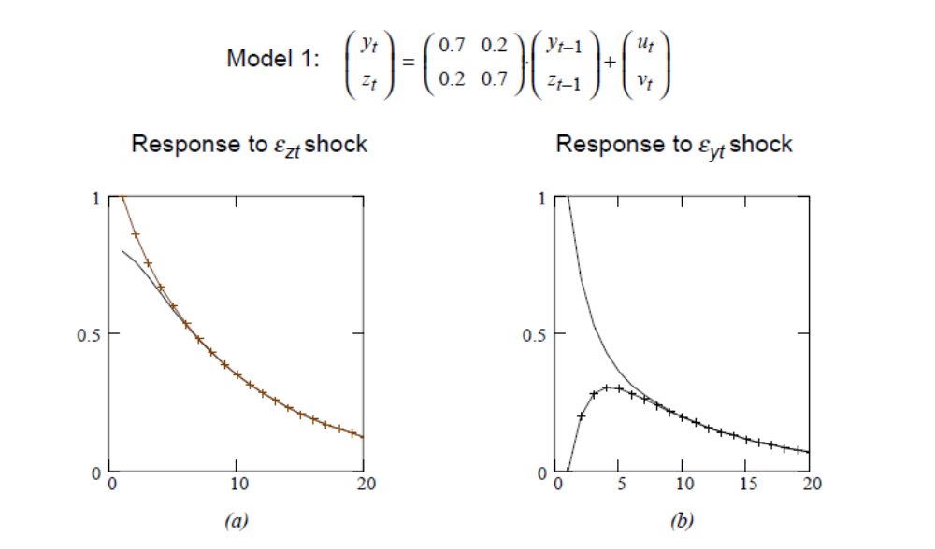
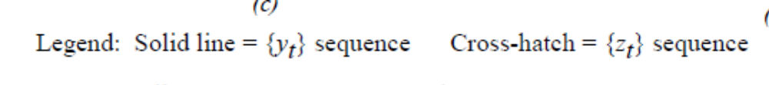


Slide 47
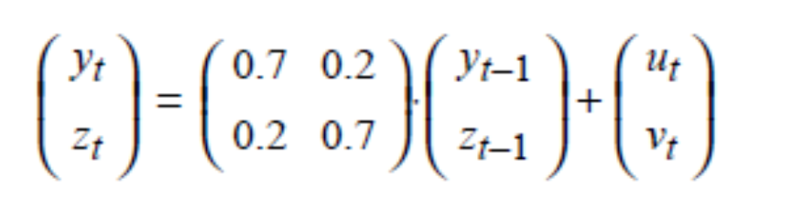
What happens if we reverse the Cholesky decomposition (i.e.. we set b₂₁=0).
  In this case, since we assumed symmetry, we would just reverse the IRF of the two shocks
  But, in general, this is not the case
What happens if we set a₁₂= a₂₁=-0.2

Slide 48
The importance of the ordering depends on the magnitude of corr(e₁,e₂)
If this correlation is zero, the ordering is irrelevant (because ε_{yt}=e_{1t} and ε_{zt}=e_{2t})
  If there is no correlation b₁₂=b₂₁=0
The higher the correlation the more important the ordering.
  If corr(e₁,e₂)=1 and we set b₂₁=0 then ε_{zt}=e_{2t}=e_{1t}. If we set b₁₂=0 then ε_{yt}=e_{1t}=e_{2t}.
  What if corr(e₁,e₂)=-1?

Slide 49
Test the hypothesis that ρ₁₂=0
Assuming that the correlation coefficient is distributed normally with mean zero and standard deviation of 1/(T^{0.5}) you can use a t table to test if ρ is different from zero

Slide 50
How do we choose the ordering
Economic theory
Try with different orderings and if the results change dramatically investigate more

Slide 51
How do you build confidence intervals for the IRF?
IRF are built using estimated coefficients and since each coefficient is estimated imprecisely, the IRF also contains errors
How do we test the significance of IRF?
  Delta method
    The delta method expands a function of a random variable around its mean, usually with a one-step Taylor approximation, and then takes the variance.
    If we want to approximate the variance of G(X) where X is a random variable with mean μ and G() is differentiable, we can use:
    G(X) = G(μ) + (X-μ)G'(μ) +remainder
    Var(G(X)) = Var(X)*[G'(μ)]² (approximately)
    This is a good approximation if X has a high probability of being close enough to its mean (μ)
  Bootstrapping

Slide 52
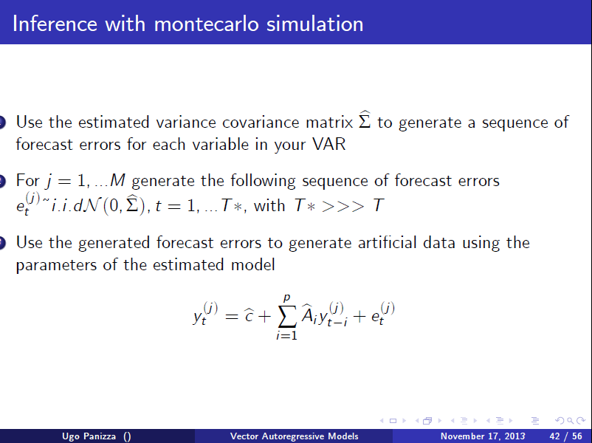

Slide 53
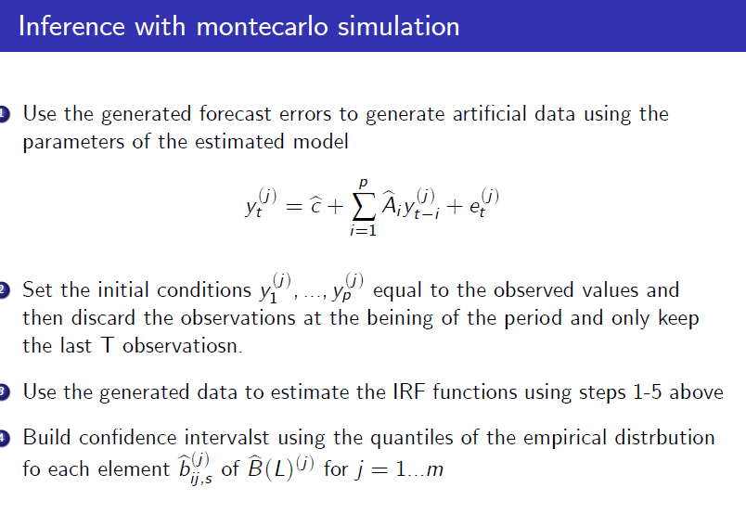

Slide 54
Variance decomposition
Unrestricted VARs are overparametrized and they are not very good for forecasting
But, we can learn about the relationship among the variables in the system by looking at the properties of the forecast error
The forecast error variance decomposition shows the proportion of the movements in a sequence which is due to its own shock versus the shocks to other variables
If shocks to y explain none of the forecast errors variance of x, we say that x is exogenous with respect to y

Slide 55

Variance decomposition
NB:
ALL expectations are taken at time t

Slide 56
Variance decomposition
The n-step-ahead forecast is
Ex_{t+n}=(I+A₁+A²₁+A³₁+A⁴₁+…A^{n-1}₁) A₀+A₁^{n}x_{t}
and the forecast error is
x_{t+n}-Ex_{t+n}=A₁^{n-1}e_{t+1}+A₁^{n-2}e_{t+2}+..+A₁²e_{t+n-2}+A₁¹e_{t+n-1}+e_{t+n}
NB:
ALL expectations are taken at time t

Slide 57



Variance decomposition
An alternative way is to start from the VMA form of the structural model
and write the n-step-ahead forecast error as
OR
NB:
ALL expectations are taken at time t

Slide 58
Variance decomposition
Focus on y_{t}, the n-step-ahead forecast error is
y_{t+n}-Ey_{t+n}=φ₁₁(0)ε_{yt+n}+φ₁₁(1)ε_{yt+n-1}+..+φ₁₁(n-1)ε_{yt+1}+
+ φ₁₂(0)ε_{zt+n}+φ₁₂(1)ε_{zt+n-1}+..+φ₁₂(n-1)ε_{zt+1}
And its variance:
σ_{y}(n)²=σ_{y}²(φ₁₁(0)² +φ₁₁(1)² +..+φ₁₁(n-1)²)+
+ σ_{z}²(φ₁₂(0)² +φ₁₂(1)² +..+φ₁₂(n-1)²)+
  Since φ_{ij}(i)² are non-negative the variance of the forecast error increases with n

Slide 59
Variance decomposition
And we can decompose the variance of the forecast error into proportions due to shocks in the ε_{yt} and ε_{zt} sequences
1=[σ_{y}²(φ₁₁(0)² +φ₁₁(1)² +..+φ₁₁(n-1)²)]/σ_{y}(n)²+
+ [σ_{z}²(φ₁₂(0)² +φ₁₂(1)² +..+φ₁₂(n-1)²)]/σ_{y}(n)²+
The forecast error variance decomposition shows the proportion of the movements in a sequence which is due to its own shock versus the shocks to other variables

Slide 60
Variance decomposition
If shocks to y explain none of the forecast errors variance of x, we say that x is exogenous with respect to y
If shocks to y explain 100% the forecast errors variance of x at all n, then we can say that x is fully endogenous with respect to y
Normally, a variable explains most of its variance at short horizons and a decreasing share at longer horizons

Slide 61
Variance decomposition
Note that in order to do a variance decomposition we also need to assume an ordering or some other set of restrictions
  If not, we cannot recover the φ
If we set b₂₁=0 we are forcing ε_{zt} to explain 100% of one-step ahead forecast error variance of z_{t}. (the opposite happens if we set b₁₂=0)
This dramatic effect of ordering should disappear at longer forecast horizons

Slide 62
Variance decomposition
It is useful to check what happens with different orderings
If things remain different even at long forecast horizons we really need to think hard about the ordering
Again, the magnitude of ρ₁₂ is very important
  If the correlation among innovations is small, identification is not a big issue and alternative orderings should yield similar results

Slide 63
Innovation accounting
Impulse response functions and forecast error variance decomposition are jointly called innovation accounting
They are useful to examine the interrelation among variables

Slide 64
Now, let’s do it (example 1)
We will follow Leeper, Sims and Zha (LSZ) (1996) “What Does Monetary Policy Do?”
We will use monthly data (July 1959-March 1996 period) and consider a VAR with 6 variables
    Log of US output (ly)
    Log of US prices (lp)
    Log of commodity prices (lpcm)
    US Fed funds rate (usff)
    Seasonally adjusted total bank reserves (smtr)
    Seasonally adjusted non-borrowed reserves (smnbr)

Slide 65
How many lags?
We have a list of variables, but how many lags should we include?
We can use information criteria
STATA has a command called VARSOC which produces various information criteria and suggests the best lag length
  IC produced by VARSOC:
    Final prediction error (FPE); Akaike's information criterion (AIC); Schwarz's Bayesian information criterion (SBIC); Hannan and Quinn information criterion (HQIC)
  AIC chooses longer lag length; SBIC and HQIC are more parsimonious
  With monthly data people usually look at SBIC

Slide 66

Up to two years

Slide 67

Let’s try with a VAR2
Does the ordering
matter?
var lpcm lp ly usff smtr smnbr, lags(2)
Not, now, but it will matter later

Slide 68

Is the model stable?
We can use the command VARSTABLE to check whether all the roots are inside the unit circle
Complex roots

Slide 69


Are the residuals normal?
Skewness
Kurtosis
Normal variables have
skewness=0 and kurtosis=3
We always reject the null
of normality

Slide 70

Are the residuals autocorrelated?
OK, diagnostics really suck
The residuals are not normal and
they are autocorrelated
Since we have annual data,
lets’ try with a model with 12 lags
(VAR(12))
We always reject H0, we have big time
Autocorrelation!

Slide 71


Slide 72


Slide 73


OK

Slide 74

NO GOOD!

Slide 75

GOOD!
So maybe we should use a VAR(12),
In fact several people suggest that
with monthly data one should use
a VAR(12) or even a VAR(13)
(one year plus one month)
But let’s forget about this and follow
LSZ and use a VAR 6
(note that a VAR 6 still fails normality
tests and sometimes fails
Autocorrelation tests)
Why these test failures? Probably because we had structural
changes in the US economy

Slide 76


Slide 77
IRF
. irf create lsz1, set(lsz1) step(50)
(file lsz1.irf created)
(file lsz1.irf now active)
This command creates the IRF file with 50 step forward forecasts (it assumes an ordering)
Now we can graph the IRF. If want to graph them one by one we do the following
irf graph oirf, impulse(var) response(var)
This is telling STATA to orthogonalize the shocks using a Cholesky decomposition with the ordering that we used to estimated the VAR

Slide 78

irf graph oirf, impulse(lpcm) response(lp)

Slide 79

irf graph oirf, impulse(lpcm) response(lpcm)

Slide 80

irf graph oirf, impulse(lpcm) response(usff)
OK, this is getting boring. Luckily we have a command to combine graphs

Slide 81

irf cgraph (lsz1 lpcm lpcm oirf) (lsz1 lpcm lp oirf)
(lsz1 lpcm ly oirf) (lsz1 lpcm usff oirf)
(lsz1 lpcm smtr oirf) (lsz1 lpcm smnbr oirf) COMBINE

Slide 82


response of lpcm

Slide 83


Impulse of lpcm

Slide 84

. irf cgraph (lsz1 smnbr lpcm oirf) (lsz1 smnbr lp oirf)
(lsz1 smnbr ly oirf) (lsz1 smnbr usff oirf)
(lsz1 smnbr smtr oirf) (lsz1 smnbr smnbr oirf)
Do you remember the original ordering

Slide 85



Slide 86

. irf cgraph (lsz1 ly lpcm oirf) (lsz1 ly lp oirf)
(lsz1 ly ly oirf) (lsz1 ly usff oirf) (lsz1 ly smtr oirf)
(lsz1 ly smnbr oirf)

Slide 87



Slide 88

We can also look at the cumulative effect
irf cgraph (lsz1 lpcm lpcm coirf) (lsz1 lpcm lp coirf)
(lsz1 lpcm ly coirf) (lsz1 lpcm usff coirf)
(lsz1 lpcm smtr coirf) (lsz1 lpcm smnbr coirf)

Slide 89

Or both
irf cgraph (lsz1 lpcm lpcm oirf) (lsz1 lpcm lp oirf)
(lsz1 lpcm ly oirf) (lsz1 lpcm lpcm coirf)
(lsz1 lpcm lp coirf) (lsz1 lpcm ly coirf)

Slide 90
Forecast error variance decomposition
The forecast error variance decomposition shows the proportion of the movements in a sequence which is due to its own shock versus the shocks to other variables
If shocks to y explain none of the forecast errors variance of x, we say that x is exogenous with respect to y
If shocks to y explain 100% the forecast errors variance of x at all n, then we can say that x is fully endogenous with respect to y
Normally a variable explains most of its variance at short horizons and a decreasing share at longer horizons

Slide 91

Forecast error variance decomposition
irf ograph (lsz1 lpcm lpcm fevd) (lsz1 lp lpcm fevd)
(lsz1 ly lpcm fevd) (lsz1 usff lpcm fevd)
(lsz1 smtr lpcm fevd) (lsz1 smnbr lpcm fevd)

Slide 92

. irf ograph (lsz1 lpcm usff fevd) (lsz1 lp usff fevd)
(lsz1 ly usff fevd) (lsz1 usff usff fevd)
(lsz1 smtr usff fevd) (lsz1 smnbr usff fevd)

Slide 93


Always zero at zero because there is no forecast error

Slide 94

irf cgraph (lsz1 usff lpcm oirf) (lsz1 usff lp oirf)
(lsz1 usff ly oirf) (lsz1 usff usff oirf)
(lsz1 usff smtr oirf) (lsz1 usff smnbr oirf)
Anything strange?

Slide 95

irf graph oirf, impulse(usff) response(lp)
Price puzzle

Slide 96
Why do we get these puzzles?
Maybe our Cholesky ordering is not appropriate
Can we improve things if we move to a structural VAR?
  Language is confusing.
  Cholesky is also structural, but for some reason people sometime use structural when they identify the VAR with something different from Cholesky

Slide 97
Structural VARs
VARs are often criticized for having little economics
Economics dictates the choice of variables and, maybe, the ordering. Everything else is mechanical
  If the ordering is not justified by sound economic theory and the residuals are correlated we may get bad results
  Of course you can try different orderings, but when you have more than two variables you need to look at a lot of stuff
    (with n variables you have n! possible orderings)
  And what if different orderings yield dramatically different results?
Can we use economic theory instead of Cholesky to recover the structural shocks (ε) from the residuals (e)?
Yes, as long as economic theory allows us to impose (N²⁻N)/2 restrictions

Slide 98
Structural VARs
Types of restrictions
  Coefficient restrictions
    You may know that one coefficient is one (2, 7, -10, whatever)
    You may know that the sum of a set of coefficients is zero
  Variance restrictions
    You may know that the variance of a given structural shock is 1 (3, 7, 19, whatever)
  Sign restrictions
    You may know that the price effect of a demand shock is positive
  Symmetry restrictions
    You may know that a given parameter is equal to another parameter (half, twice, the negative, whatever)
    You may know that the sum of some parameters are equal to another parameter
    You may know that the variance of a given structural shock is equal to the variance of another structural shock (half, twice, whatever)

Slide 99
The Structural VAR (SVAR)
The aim of a structural VAR is to use economic theory (rather than Cholesky) to recover the structural innovation

